Slide 1
PETER PAUL RUBENS
HISTORY OF WESTERN ART
BFA-II

Slide 2
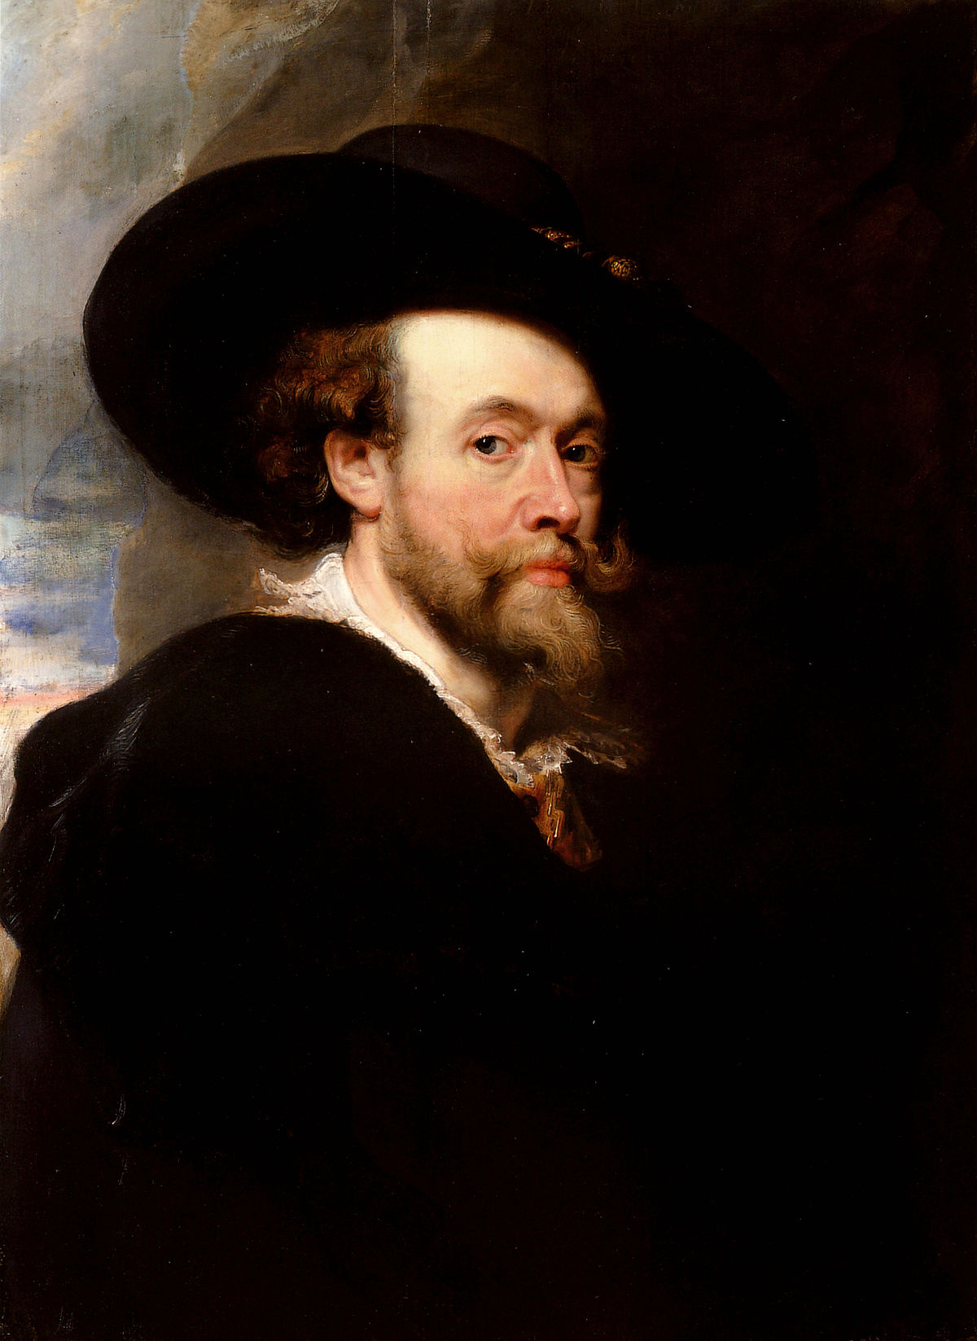
Self Portrait (1623)

Slide 3
“My passion comes from the heavens, not from the worldly musings”
Peter Paul Ruben
“I am just a simple man standing alone with my old brushes, asking God for inspiration”
Peter Paul Ruben

Slide 4
Peter Paul Rubens (A Flemish Painter)
Peter Paul Rubens was a Flemish artist who worked mostly in the Baroque tradition. His work earned him a glowing reputation amongst Antwerp’s noble elite with rare financial stability. Many of his paintings included mythical and historical symbolism and he also favored images of hunting and noble life. Rubens classic style often involves bold colors and subjects.
He was born in 1577 at Siegen, Westphalia and died in 1640 at Antwerp, Belgium.
Named after the saints Peter and Paul, Peter Paul Rubens was one of the six children of Jan Rubens. He belongs to the family of lawyers, tanners and burgesses in Antwerp which was one of the richest and busiest seaport in Europe at that time. His father was a lawyer, an alderman involved in politics while his mother was a heiress and a writer from the Southern Netherlands.
In 1589, Antwerp went through religious conflicts and wars. Raised under his mother’s faith, Rubens followed Roman Catholicism and educated in humanist traditions, with the study of Latin and classical literature. He attended school in Cologne where he surpassed all his fellow students as his father had instilled a lasting love of learning in his boys.
He was interested to opt painting as a career, but his mother desired to make him a courtier due to his naturally diplomatic personality.

Slide 5
Peter Paul Rubens (A Flemish Painter)
Stephen Longstreet explained in the introduction to his book The Drawings of Rubens (1964) stated that “...the father dies when his son Paul was ten, the handsome, intelligent boy became a court page but was already drawing ... His happy view of the world, his love of the human figure and well-set table, gave Peter Paul Rubens a taste for the good life. He showed it in his portfolio of drawings celebrating women, horses, the play of gods and goddesses, the fruitful fields, the peasants dancing, the filled, smoking stables, the feel of silk and furs, armor and marble, marked out by his magic lines...”
These young experiences of courtly life and noble and royal circles were useful later in life since the young Rubens gained confidence and knowledge of the required social protocol to associate with aristocratic and royal patrons.
In 1591, at age 14, Rubens was apprenticed to Tobias Verhaecht, a distant relative and uninspired landscape painter of little renown, in Antwerp.
After a year, he began working in the studio of Adam van Noort, a more talented figure painter and popular master among the students, where he remained for four years.
Afterwards, he was made senior apprentice to Antwerp’s most accomplished artist, Otto van Veen, foremost among the city’s history painters.

Slide 6
Peter Paul Rubens (A Flemish Painter)
By 1598, at age 21, Peter Paul qualified as an independent master artist with the Guild. He could speak Latin, Greek, French, and Italian as well as the Flemish and Spanish of his native home. Within three years, he was made a franc-maitre (French master) of the Guild of St. Luke, which was the requirement for any artist to engage apprentices or sell paintings to the public. The guild was made up of lively artists, printers, ceramic makers, type designers, and goldsmiths who provided contacts for each other from all areas of society.
In May 1600, Rubens traveled to Italy where he first visited Venice to see the paintings of Titian, Veronese, and Tintoretto. He was immediately influenced by the rich colors and dramatic compositions. In Venice, he also met a gentleman who worked for the Duke of Mantua, Vincenzo Gonzaga, who was so impressed with Rubens friendly, sober, and self-disciplined character that he recommended him to the Duke, who was “...a man very fond of luxury, painting and all the liberal arts...” as explained by Kristin Lohse Belkin in her book, Rubens.
Rubens became court painter to the Duke, who supported him financially with travels to Rome and Spain to study classical art, paint his own masterpieces, and make copies of the Italian master paintings including those of Michelangelo, Raphael, Leonardo da Vinci, and Caravaggio. Rubens himself wrote many years later, “I served the Gonzaga family for many years, and while I was young the delights of a stay in that part of Italy were very much to my liking”.

Slide 7
Peter Paul Rubens (A Flemish Painter)
Rubens also recommended worthy purchases of art to the Duke and performed diplomatic missions until he returned to Italy in 1604. He and his brother Philip rented an apartment with a studio, hired servants, and enjoyed entertaining their friends with whom they discussed their work.
On a second visit to Rome, Rubens studied the ancient Greek and Roman sculptures, and further explored the masters of the Renaissance. His own advice exists in the only surviving piece of his theoretical writing from a now lost notebook: “...I am convinced that in order to achieve the highest perfection one needs a full understanding of the statues, indeed a complete absorption in them; but one must make judicious use of them and before all avoid the effect of stone...”.
He painted many portraits during this period that influenced later artists such as Anthony van Dyck, Joshua Reynolds, and Thomas Gainsborough.
In October 1608, Rubens left Rome abruptly after learning that his mother was seriously ill but by the time he reached her, she had passed away. He decided to remain in Antwerp and in September 1609 became the court painter for the Archduke Albert and Archduchess Isabella in Brussels.
Soon after, Peter Paul fell in love with Isabella Brant, the eighteen-year-old niece, of his brother’s wife. Rubens and the charming and intelligent Isabella lived with her family while he had a new house built for them, now named the Rubenshuis Museum, which was finished by 1615.

Slide 8
Peter Paul Rubens (A Flemish Painter)
This Italian-influenced villa in the center of Antwerp accommodated his workshop, where he and his apprentices worked, along with his personal art collection and library, both of which were among the most extensive in the city.
During this time, Rubens grew his studio to encompass numerous students and assistants, the most famous of whom was the young Anthony van Dyck, soon to become the leading Flemish portraitist.
During the decade 1610 to 1620, the Rubens studio produced an enormous amount of altarpieces for the Roman Catholic churches.
Rubens felt compelled to blend Flemish realism with the power and fire of Michelangelo while utilizing color like Titian. Many paintings based on secular scenes of mythology, history, allegory, portraits, landscape, and hunting were also created, of which Rubens personally painted the most important people and sections.
Rubens scholar Kristin Lohse Belkin noted that the Danish court physician Otto Sperling observed the process during a visit to Rubens studio in 1621 as “...a good number of painters each occupied on a different work, for which Mr. Rubens had provided chalk drawings with touches of color added here and there. The young men had to work these up fully in paint, until finally Mr. Rubens would add the last touches with the brush and colors. All this is considered a Rubens work; thus he gained a large fortune, and kings and princes have reaped gifts and jewels upon him”.

Slide 9
Peter Paul Rubens (A Flemish Painter)
Rubens claimed to be “...by natural instinct, better fitted to execute very large works than small curiosities”. This particular strength and talent played a very important role in his career as his focus shifted from Antwerp to the royal European courts.
Between 1627 and 1630, Rubens diplomatic career was in full swing as he moved between the courts of England and Spain in an attempt to bring peace between the two countries. A more private reason for the traveling was that his wife Isabella had died in the summer of 1626, probably due to the plague, and he desired a change of surroundings. As the artist said, according to Kristin Lohse Belkin “...I should think a journey would be advisable, to take me away from the many things which necessarily renew my sorrow...The novelties which present themselves to the eye in a change of country occupy the imagination and leave no room for a relapse into grief”.
Unfortunately, these diplomatic meetings had little political consequence. Nevertheless, Rubens was greatly appreciated. He was knighted by Charles I of England, Philip IV of Spain, and awarded an honorary Master of Arts Degree from Cambridge in 1629. He resumed his study of the paintings of Titian; it has been said that Rubens copied every Titian in King Philip’s collection.

Slide 10
Peter Paul Rubens (A Flemish Painter)
Rubens last decade was spent freely pursuing the most interesting commissions and his own artistic inspirations in and around Antwerp. In 1630, at the age of 53 years, he married his first wife Isabella’s niece, the beautiful 16-year-old Helene Fourment, whom he also used as his model in many of his paintings.
During these final ten years, Helene bore Rubens five children. Plagued by arthritis, Rubens body had become frail yet he continued to work. He wrote to his friend in 1634, “...Today I am so overburdened with the preparations for the triumphal entry of the Cardinal-Infante, that I have time neither to live or to write... I believe you would not be displeased at the invention and variety of subjects, the novelty of designs and the fitness of their application”. In 1635, he bought a country estate near Antwerp, Het Steen in Elewijt, where he painted primarily landscapes of a countryside filled with humans in harmony with nature. He died in May 1640 and his remains were buried in the Jacobskerk in Antwerp.
A quotation from Juvenal, the Roman poet of The Satires, was carved in stone over the entrance to Rubens garden. As Samuel Edwards explained, it was an apt description of Rubens hearty and well-lived life: “...Let us leave to the gods the care of dispensing their benefits to us and of giving us what we most need. They love men better than men love themselves. Let us ask them only for health of body and soundness of mind, for a strong soul free from the fear of death and untouched by anger or vain desires”.

Slide 11
Main features of Peter Paul Rubens
He famously fused a mastery of Flemish realism with the traditions of the Italian Renaissance to produce a powerful and exuberant style that epitomized the immensely popular Baroque movement, promoted by the Counter Reformation in efforts to re-establish the grandeur of the Catholic Church. This style emphasized movement, color, drama, and sensuality, and reinvigorated painting with a new lust for life after a relatively conservative period for art.
Rubens is most known for his highly charged compositions that reference aspects of classical and Christian history. His altarpieces, portraits, and landscapes of mythological and allegorical subjects give a true glimpse of the concerns and climate of the times in which he lived.
Rubens signature portrayal of the female form was coined “Rubenesque”, a term that remains widely recognized today to describe voluptuous nudes.
Alongside Raphael, Rubens was pivotal in establishing the concept of a thriving artist’s studio into the art lexicon. His large studio in Antwerp was a production hub for paintings popular with nobility and art collectors throughout Europe. His bustling workshop employed many artists and apprentices who would help accomplish a large and prolific volume of work.
Bold colors, mythical ad historical symbolism, Dynamism, Vitality, Contrast of light and dark, Dramatic gesture and action, Dramatic compositions, Muscular forms inspired from Michelangelo.

Slide 12
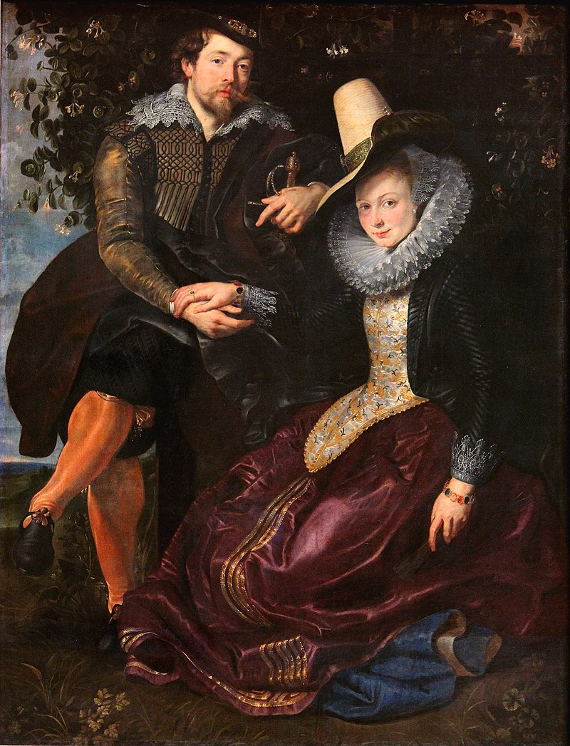
The Honeysuckle Bower (1609)

Slide 13
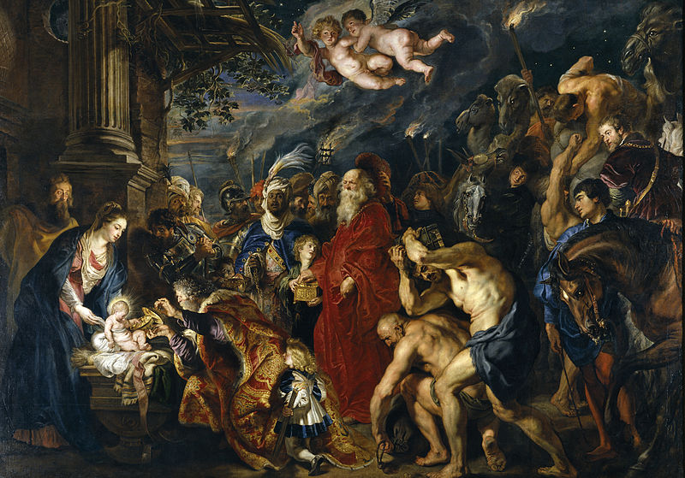
Adoration of the Magi (1609)

Slide 14
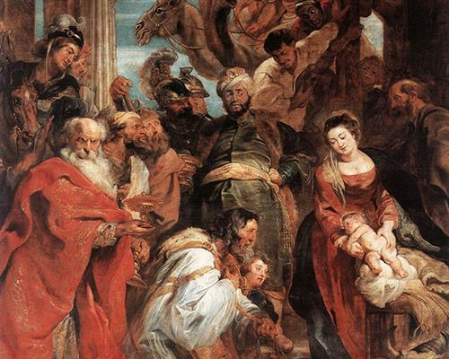
Adoration of the Magi (1624)

Slide 15
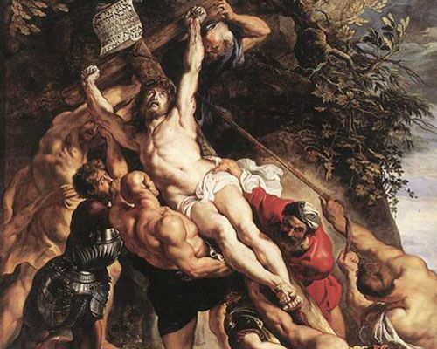
Elevation of the Cross (1611)

Slide 16
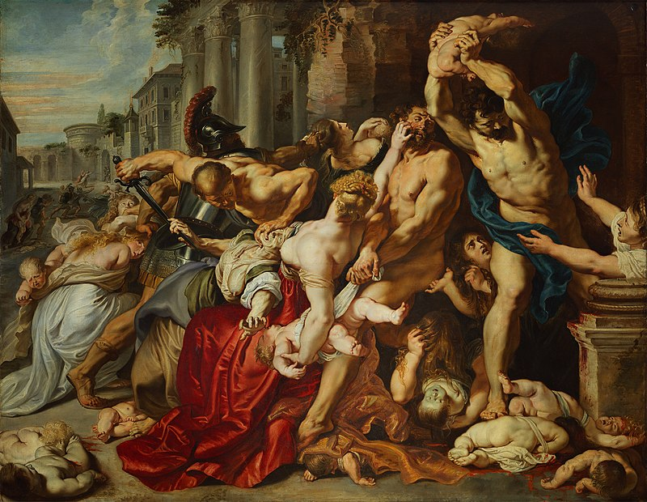
Massacre of the Innocents (1611-12)

Slide 17
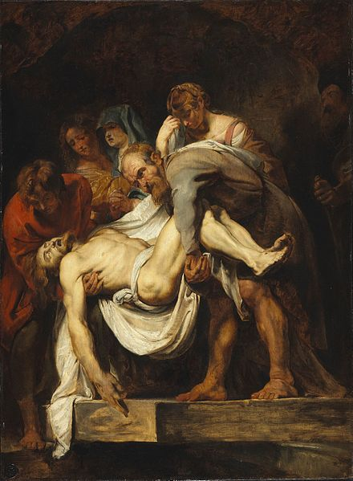
The Entombment (1612-14)

Slide 18
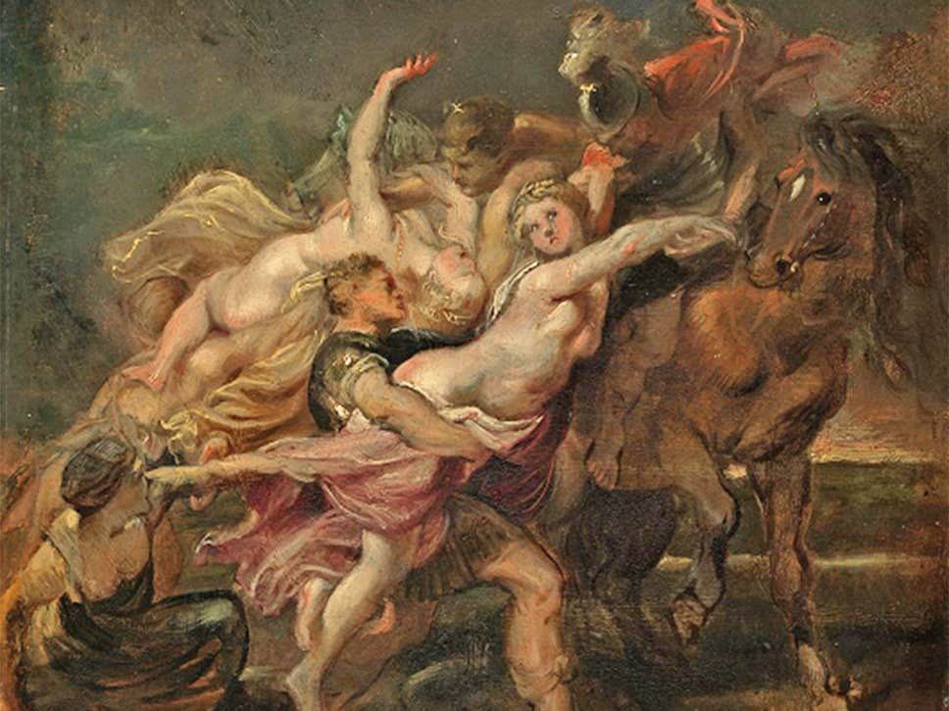
The Rape of the daughters of Leucippus (1610-11)

Slide 19
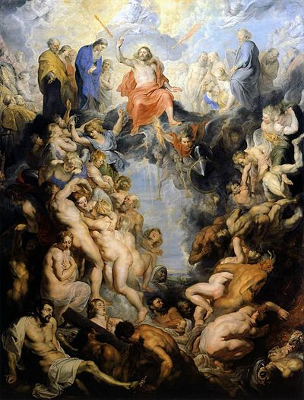
The Last Judgement (1614-17)

Slide 20
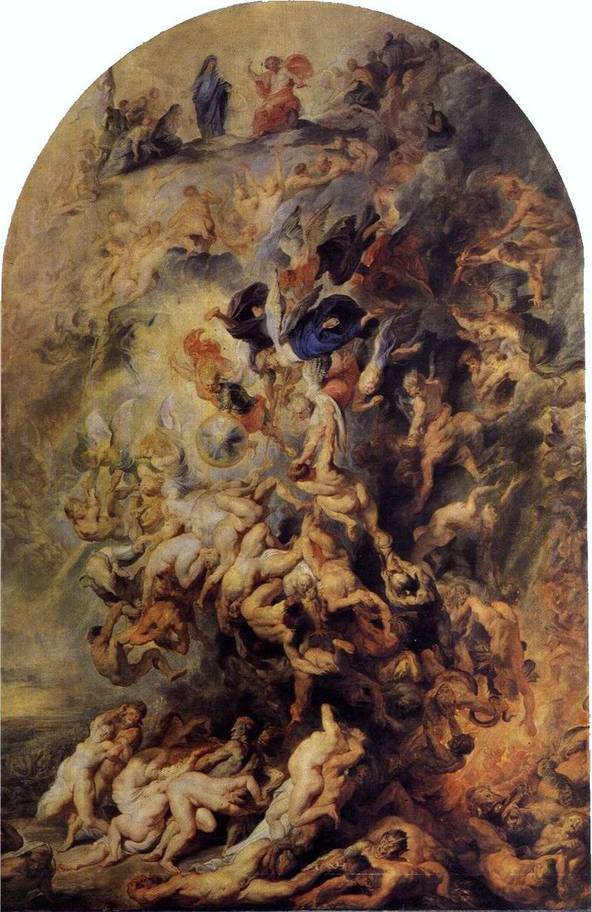
The Last Judgement (?)

Slide 21
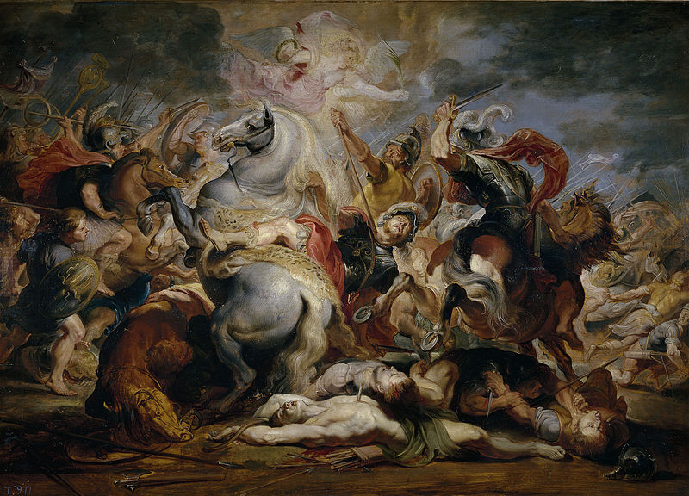
The Death of Decius Mus (1616-17)

Slide 22
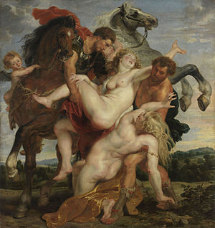
The Rape of the daughters of Leucippus (1618)

Slide 23
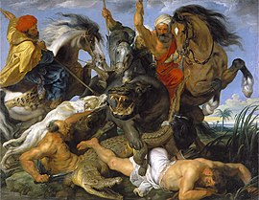
The Hippopotamus and Crocodile Hunt (1615-16)

Slide 24
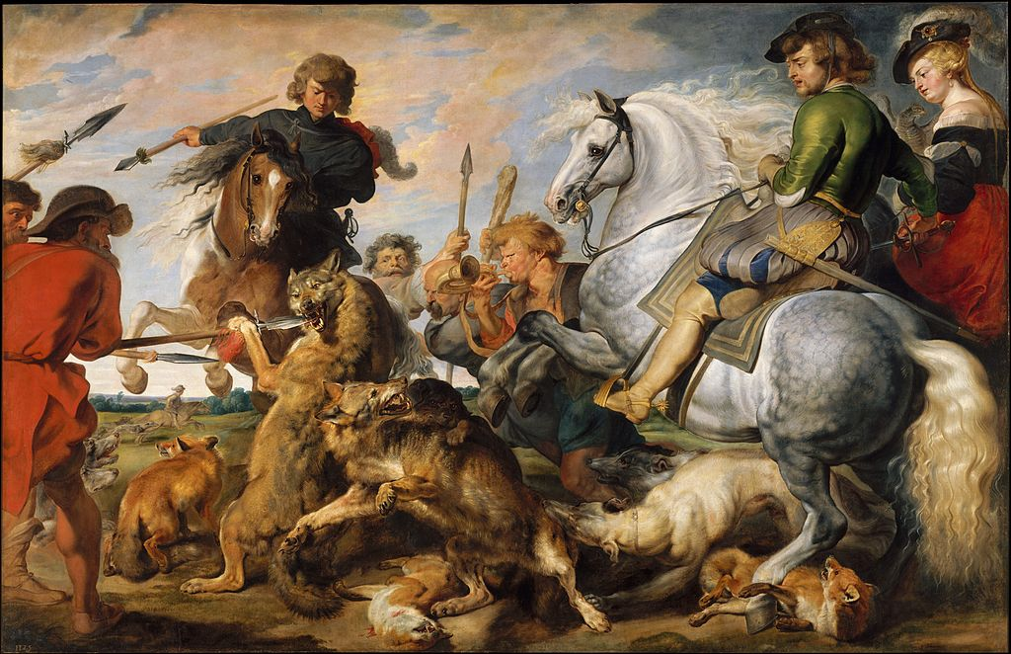
Wolf and Fox Hunt (1616)

Slide 25
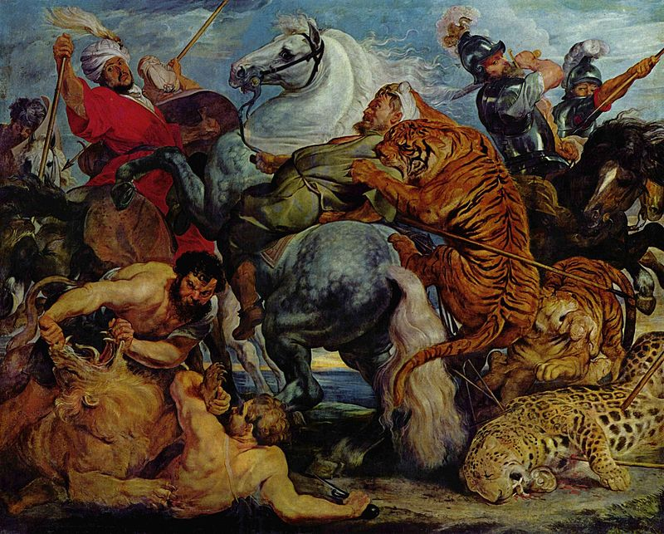
The Tiger Hunt (1617-18)

Slide 26
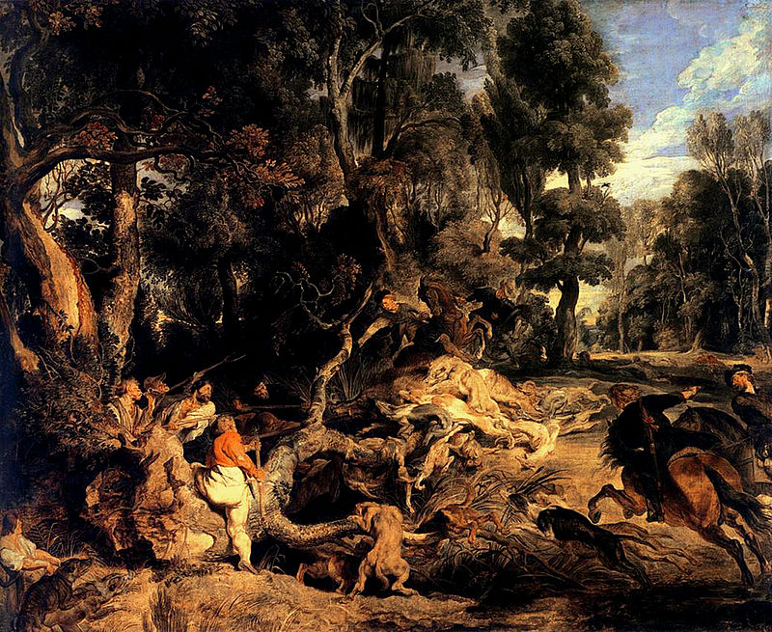
The Wild Boar Hunt (1618-20)

Slide 27
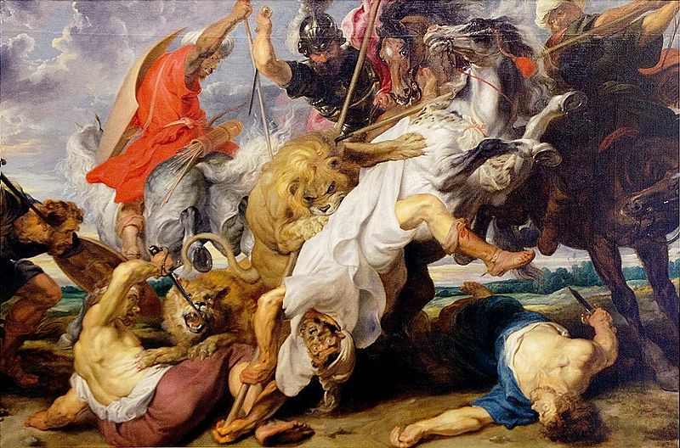
Lion Hunt (1621)

Slide 28
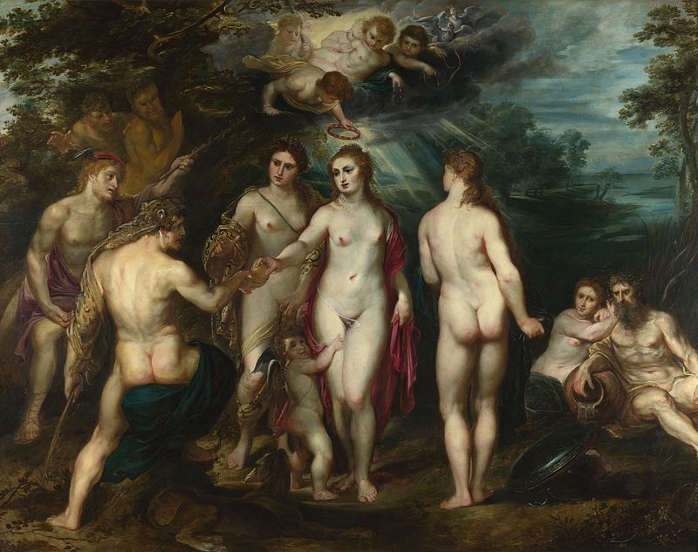
Judgement of Paris (1597-1600)

Slide 29
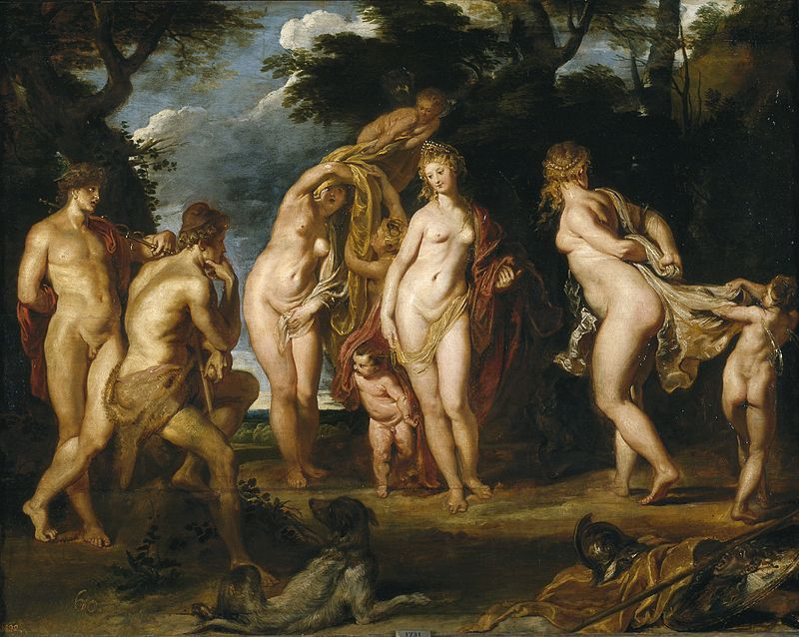
Judgement of Paris (1606)

Slide 30
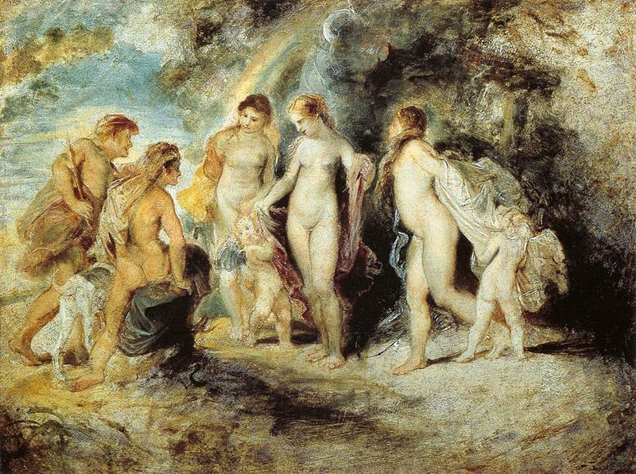
Judgement of Paris (oil sketch 1606)

Slide 31
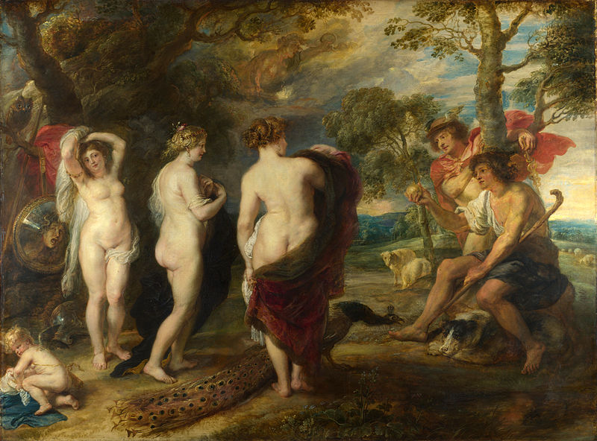
Judgement of Paris (1636)

Slide 32
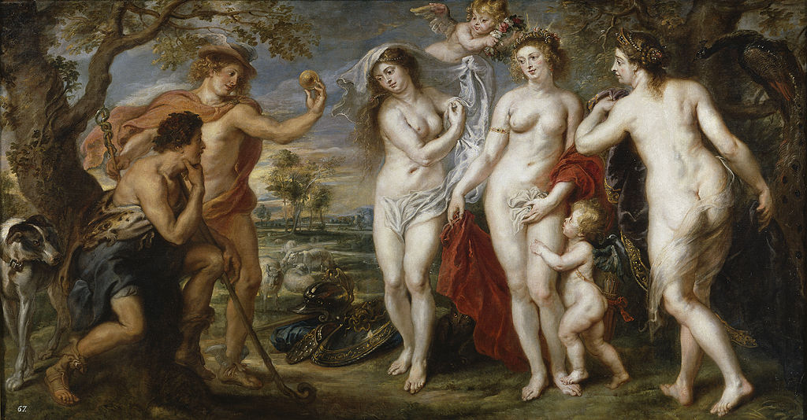
Judgement of Paris (1638-39)

Slide 33
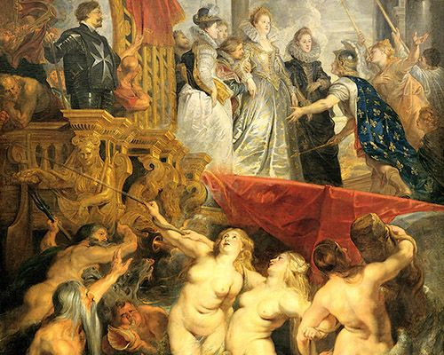
The Disembarkation at Marseilles (1625)

Slide 34
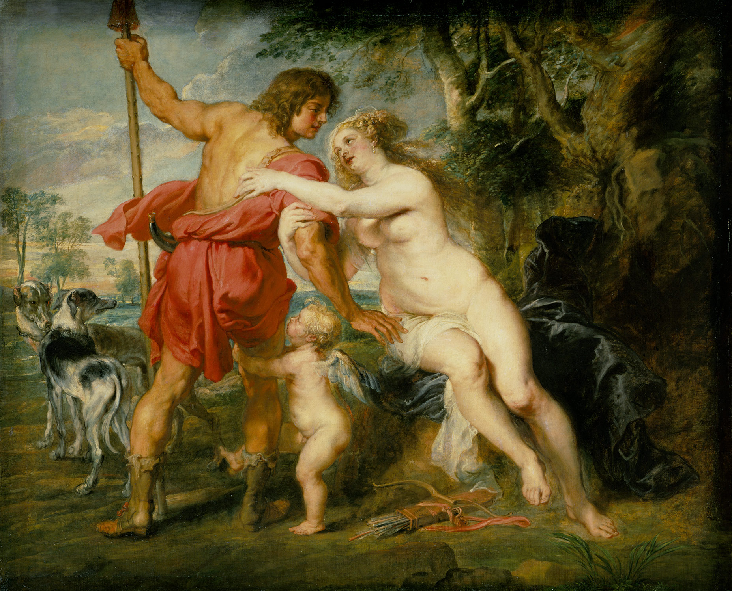
Venus and Adonis (mid 1630’s)

Slide 35
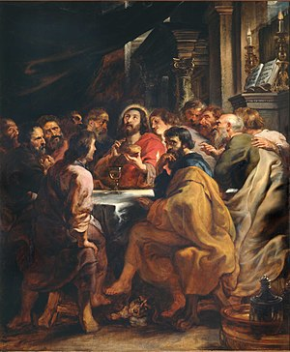
The Last Supper (1630-31)

Slide 36
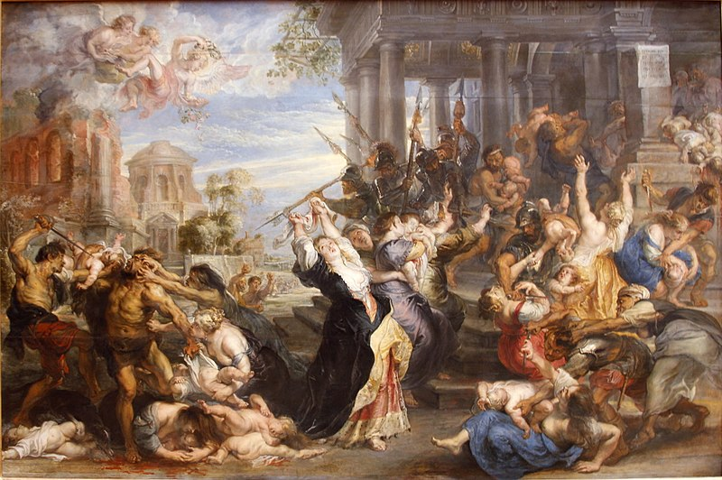
Massacre of the Innocents (1636-38)

Slide 37
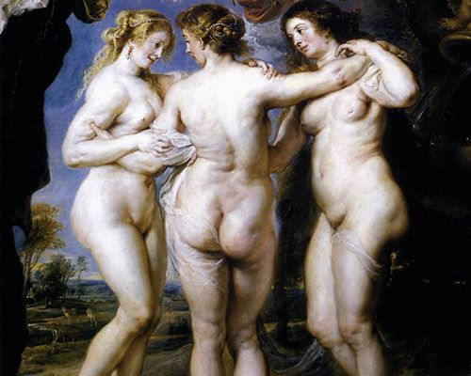
The Three Graces (mid 1639)

Slide 38
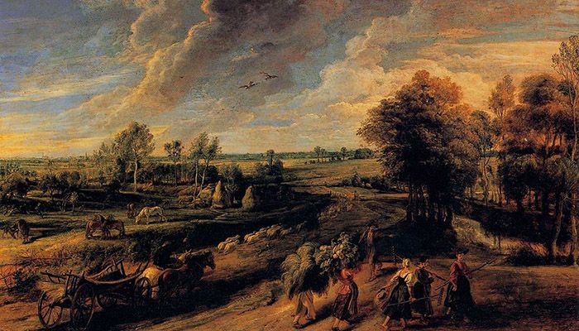
Return of the Peasant (1640)

